Slide 1


<Federico Cohen>
<October 1st, 2023>

Slide 2

Outline
Executive Summary
Introduction
Methodology
Results
Conclusion
Appendix

Slide 3
Executive Summary
Summary of methodologies
Data Collection through API
Data Collection with Web Scraping
Data Wrangling
Exploratory Data Analysis (EDA) with SQL
Exploratory Data Analysis (EDA) with Data Visualization
Interactive Visual Analytics with Folium
Interactive Dashboard with Ploty Dash
Machine Learning Prediction
Summary of all results
Exploratory Data Analysis result
Interactive analytics in screenshots
Predictive Analytics result

Slide 4
Introduction
Project background and context
Commercial space age is among us and companies are making space travel affordable for everyone. One of the most important company is Space X, which has been sending spacecraft to the international space station. In order to achieve this, Space X made their rocket launches almost inexpensive by reusing the first stage of the rocket.
Space Y is an emerging private company in the space sector and want to compete with SpaceX.
For achieving this goal its indispensable to make rocket launches affordable, minimizing the cost of the launch.
One way to predict the price of each launch is analyzing the rocket launches of Space X. This mean predicting if the Falcon 9 first Stage will land successfully. Predicting this we will be able to determine the cost of a launch.
This information will be useful for Space Y company later to bid against Space X for a rocket launch, making the space sector a more competitive environment.
Problems you want to find answers
What attributes are key factors in order to determine if the rocket will land successfully.
What is the correlation among some features that are crucial to predict the success rate of a successful landing.
What operating conditions needs to be in place to ensure a successful landing program.

Slide 5

Section 1

Slide 6
Methodology
Executive Summary
Data collection methodology:
We collect Space X launch data from an API, specifically the Space X Rest API. From this API we get information such as rocket used, payload delivered, launch specifications, landing specifications and landing outcomes.
A get request was perform using the request library to obtain this data from the Space X API.
Perform data wrangling
The data was in a JSON file and to convert this data into a Pandas Dataframe the json_normalize function was used.
Then we perform data wrangling to the raw data transforming it into a clean dataset which provide meaningful data for achieving our goal.

Slide 7
Methodology
Executive Summary
Perform exploratory data analysis (EDA) using visualization and SQL
Some attributes from the data collected can be used to determine if the first stage can be reused. So, we determine what attributes are correlated with successful landings
Also, categorical variables were converted using one hot encoding in order to prepare the data for machine learning model that was used to predict if the first stage was successfully land.
Perform interactive visual analytics using Folium and Plotly Dash
A folium map and a dashboard was made for stakeholders in order to explore the data and manipulate it in an interactive and real-time-way.
First, launch sites were analyze using Folium. This launch site locations and their close proximities were marked on an interactive map in order to see if there were any patterns among them. By doing this, we were able to choose an optimal launch site.
Second, a dashboard was built to present the information in a more understandable way and find more insights from the Space X dataset.

Slide 8
Methodology
Executive Summary
Perform predictive analysis using classification models
A machine learning pipeline to predict if the first stage of the Falcon 9 lands successfully was built.T
To achieve this the following steps were follow:
Data Preprocessing
Standardize our data,
Train_test_split, (allowing us to split our data into training and testing data)
train the model
Perform Grid Search (allowing us to find the hyperparameters that allow a given algorithm to perform best)
Confusion Matrix
Finding the best hyperparameter values help determing the model with the best accuracy using the training data.
The model that we test were: Logistic Regression, Support Vector machines, Decision Tree Classifier, and K-nearest neighbors.

Slide 9
Data Collection
Data from the Space X Rest API was collect using get request function.
Then, we decoded the response content as a Json using .json() function call and turn it into a Pandas dataframe using .json_normalize().
Once we had the dataframe we cleaned the data, filtered the dataframe to only include Falcon 9 launches, checked for missing values and fill in missing values where necessary (using the mean for payload mass).
In addition, we performed web scraping from Wikipedia for Falcon 9 launch records with BeautifulSoup. The objective was to extract the launch records as HTML table, parse the table and convert it to a pandas dataframe for future analysis.

Slide 10
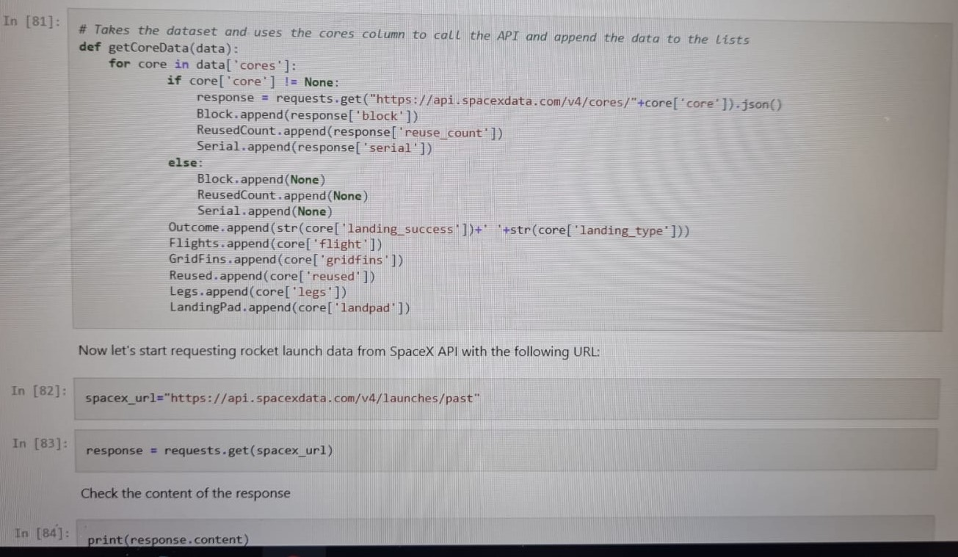
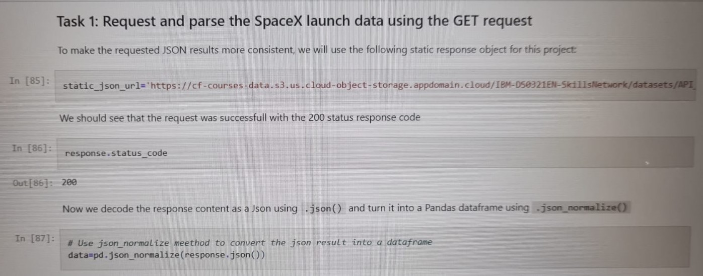
Data Collection – SpaceX API
We used the get request to the SpaceX API to collect data.
We clean the requested data, made basic data wrangling and formatting.
The link to the notebook is https://github.com/cohenfederico5/Space-Y-project/blob/main/Data%20collection.ipynb

Slide 11
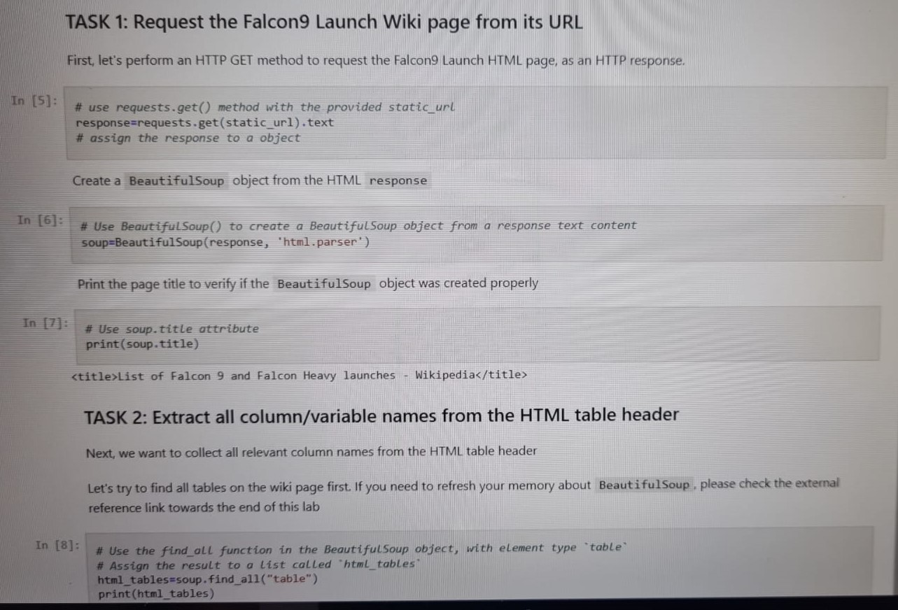
Data Collection - Scraping
We applied web scrapping to obtainFalcon 9 launch data. To achieve this we use Python BeautifulSoup package to web scrape some HTML tables.
We parsed the table and converted it into a pandas dataframe for further visualization and analysis.
The link to the notebook is https://github.com/cohenfederico5/Space-Y-project/blob/main/Data%20collection%20(web%20scraping).ipynb

Slide 12
Data Wrangling
We performed some exploratory data analysis (EDA) to find some patternsin the data and determined what would be the label for training supervised models.
We calculated the number of launches at each site, and the number and occurrence of each orbits
We created landing outcome label from outcome column and exported the results to csv.
The link to the notebook is https://github.com/cohenfederico5/Space-Y-project/blob/main/Data%20Wrangling.ipynb

Slide 13
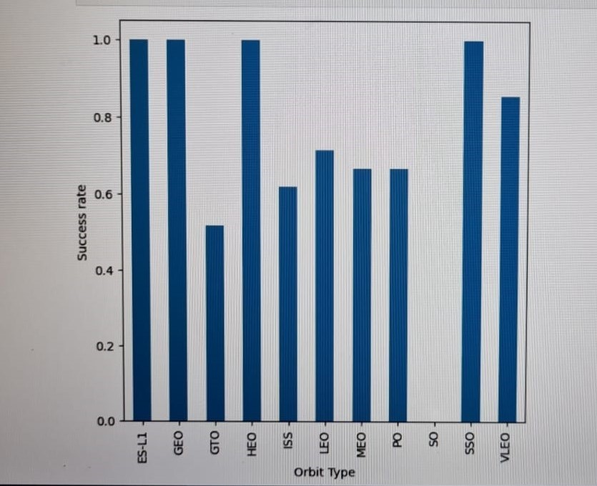
EDA with Data Visualization
We prepared data features Engineering.
We explored the relationship between some attributes (flight number and launch Site, payload and launch site, success rate of each orbit type, flight number and orbit type) and also visualize the launch success yearly trend.
The link to the notebook is https://github.com/cohenfederico5/Space-Y-project/blob/main/EDA_Data%20Visualization.ipynb

Slide 14
EDA with SQL
We applied EDA with SQL to get insights from the data. We ran different queries among we can underline the following ones:
The names of unique launch sites in the space mission.
The total payload mass carried by boosters launched by NASA (CRS)
The average payload mass carried by booster version F9 v1.1
The date when the first successful landing outcome in ground pad was achieved
The total number of successful and failure mission outcomes
The name of the booster versions which have carried the maximum payload mass
The failed landing outcomes in drone ship, their booster version and launch site names.
The link to the notebook is https://github.com/cohenfederico5/Space-Y-project/blob/main/EDA_%20SQl.ipynb

Slide 15
Build an Interactive Map with Folium
We use Folium map to marked all launch sites. We also added map objects such as markers, circles, lines to mark the success or failure of launches for each site on the map.
We assigned the feature launch outcomes (failure or success) to class 0 and 1.i.e., 0 for failure, and 1 for success.
Using the color-labeled marker clusters, we identified which launch sites have relatively high success rate.
We calculated the distances between a launch site to its proximities. We answered some question sush as:
Are launch sites near railways, highways and coastlines.
Do launch sites keep certain distance away from cities.
The link to the notebook is https://github.com/cohenfederico5/Space-Y-project/blob/main/Interactive_visual_analytics_folium.ipynb

Slide 16
Build a Dashboard with Plotly Dash
We built a dashboard application with Plotly Dash to perform interactive visual analytics on Space X launch data in real-time.
This dashboard contains input components such as a dropdown list of launch sites.
We plotted a pie charts showing the total launches by each site that you can select interacting with the dropdown.
Then, we built a range slider to select Payload Mass (Kg) to interact with a scatter point chart.
So we plotted this scatter point chart that shows the relationship between Outcome and Payload Mass (Kg) for the different booster version.
The link to the notebook is https://github.com/cohenfederico5/Space-Y-project/blob/main/spacex_dash_app.py

Slide 17
Predictive Analysis (Classification)
We created a Numpy array for the target variable (Class), transformed the data standarizing it and then we split our data into training and testing using train_test_split function.
We built different machine learning models and tune different hyperparameters using GridSearchCV.
We used accuracy as the metric for our model, improved the model using feature engineering and algorithm tuning.
We found the best performing classification model (in this case a decision tree)
The link to the notebook is https://github.com/cohenfederico5/Space-Y-project/blob/main/SpaceX_Machine_Learning_Prediction_Part_5.jupyterlite.ipynb

Slide 18
Results
Exploratory data analysis results
Launch rate of success has improved over time.
The launch site with the highest rate of success is KSC LC-39A
Some orbits presents a 100% rate of success. These are ES-L1, GEO, HEO and SS0
Interactive analytics demo in screenshots
The launch sites are all close to the coastline.
On the other hand launch sites are far away from cities so in case of a failure in the rocket launch, the possibility of making a damage to citizens is really exiguous.
Predictive analysis results
Among all the predictive model used the one that best perform is the Decision Tree model

Slide 19

Section 2

Slide 20
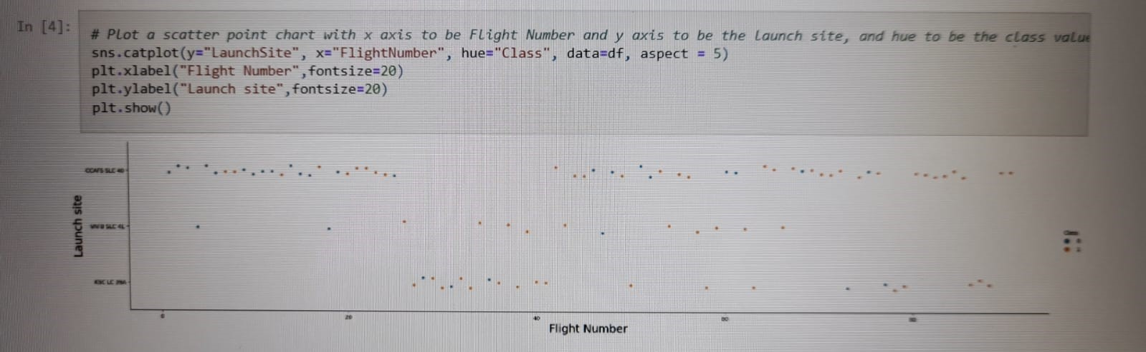
Flight Number vs. Launch Site
The main pattern we can get from the plot is that when the number of flight launch from any site increase the rate of success also increase.

Slide 21
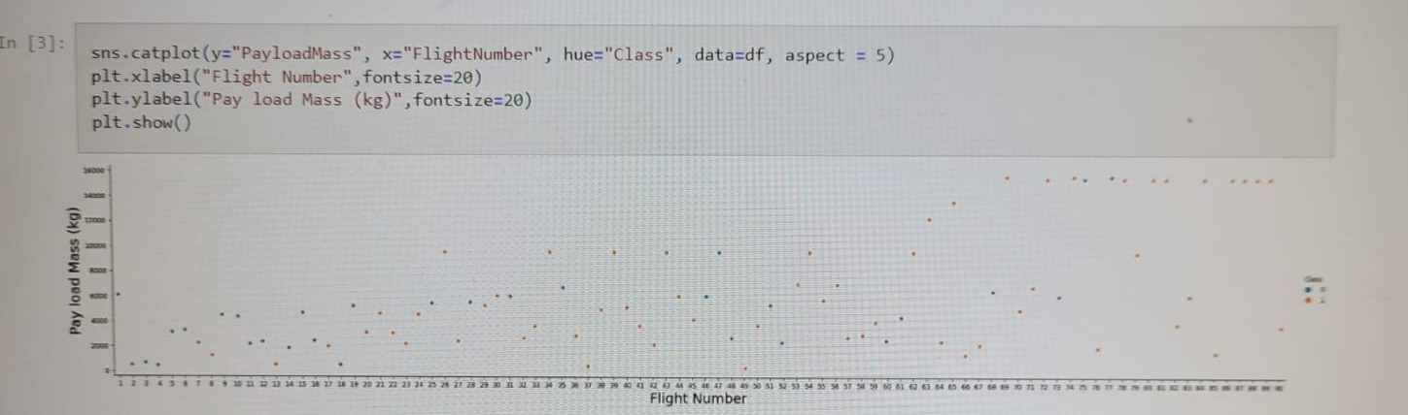
Payload vs. Launch Site
First, we can see from the plot that for the VAFB-SLC launch site there are no rockets launched for heavy payload mass greater than 10000 kg.
Also, for the CCAFS SLC 40 launch site the greater the payload mass is the higher the success rate becomes.

Slide 22
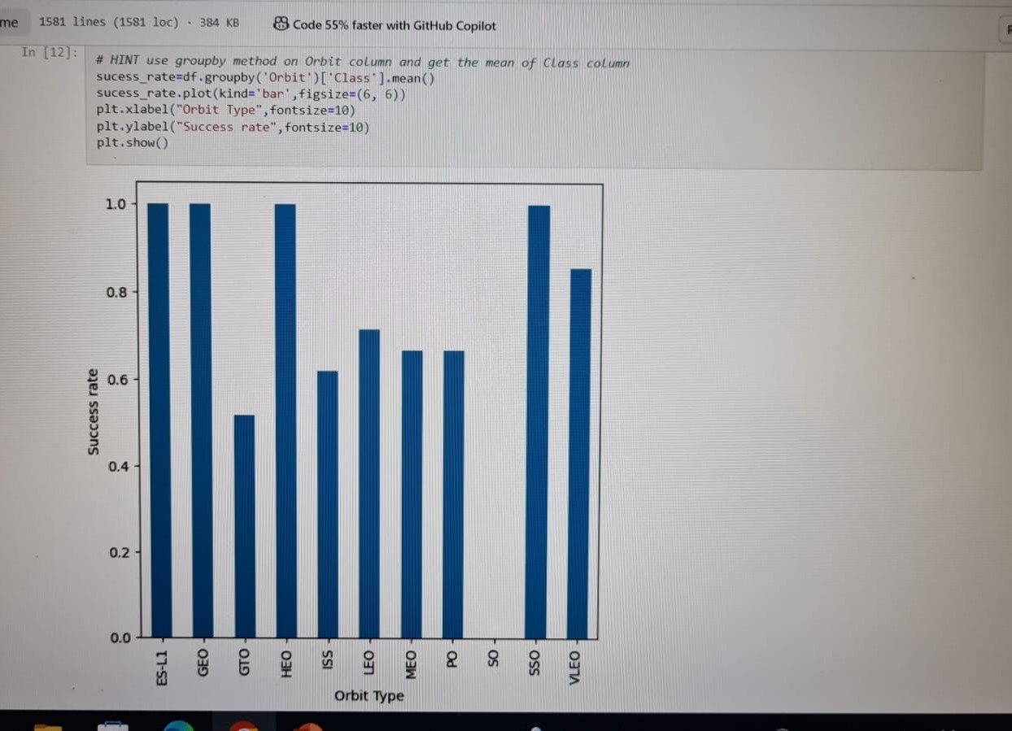
Success Rate vs. Orbit Type
We can see from the plot that the orbits ES-L1, GEO, HEO, SSO, VLEO have the bigger success rate.

Slide 23
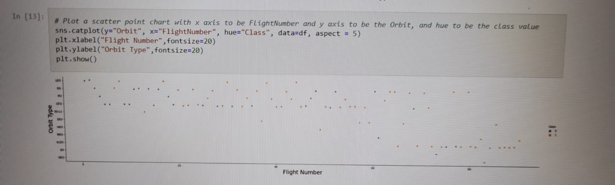
Flight Number vs. Orbit Type
From the below plot we see that in the LEO orbit the success appears to be related to the number of flights, while there seems to be no relationship between flight number when in GTO orbit.

Slide 24
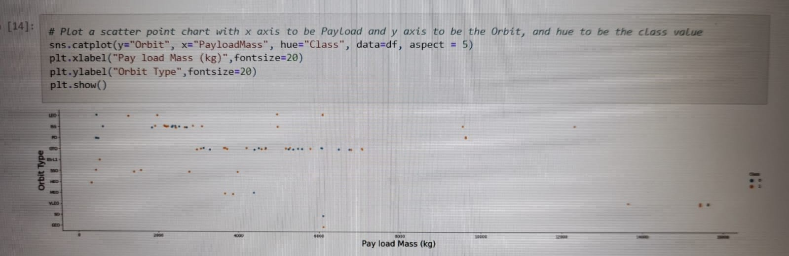
Payload vs. Orbit Type
From the plot we can observe that with heavy payloads, the successful landing rate are more for Polar, LEO and ISS orbits.
However, for GTO we can’t distinguish this tendency well as both positive and negative landing are both present.

Slide 25
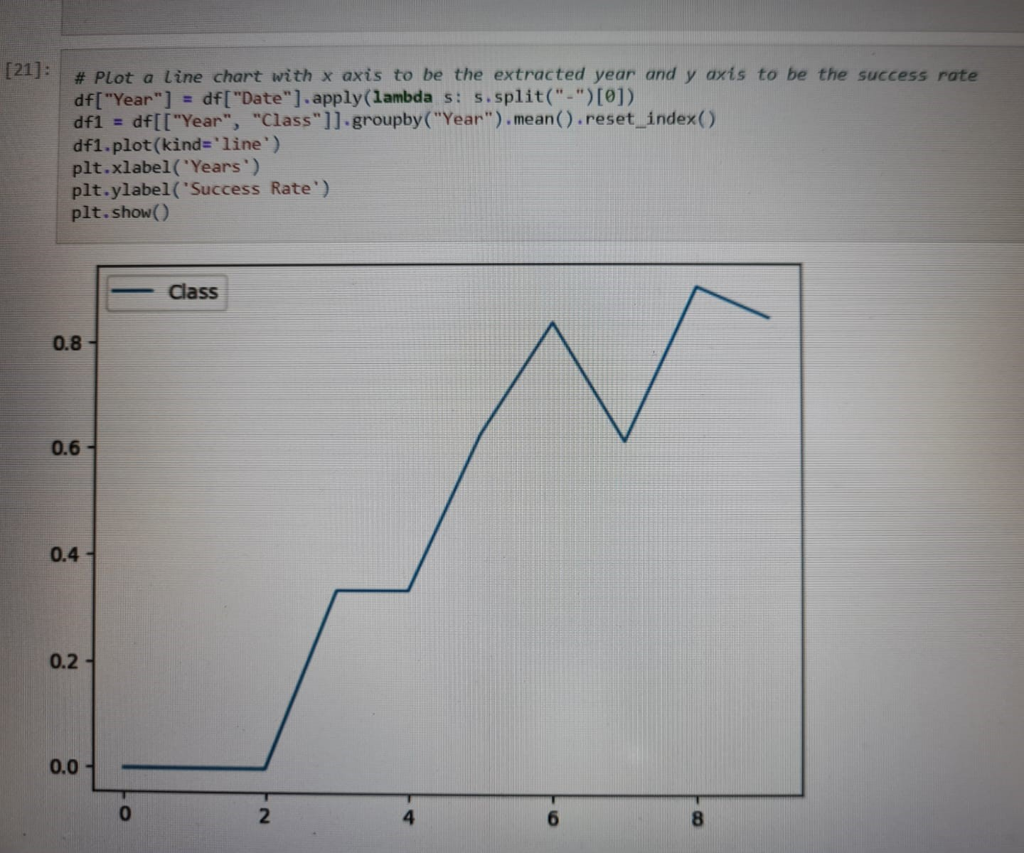
Launch Success Yearly Trend
We can see that success rate since 2013 kept increasing till 2020.

Slide 26
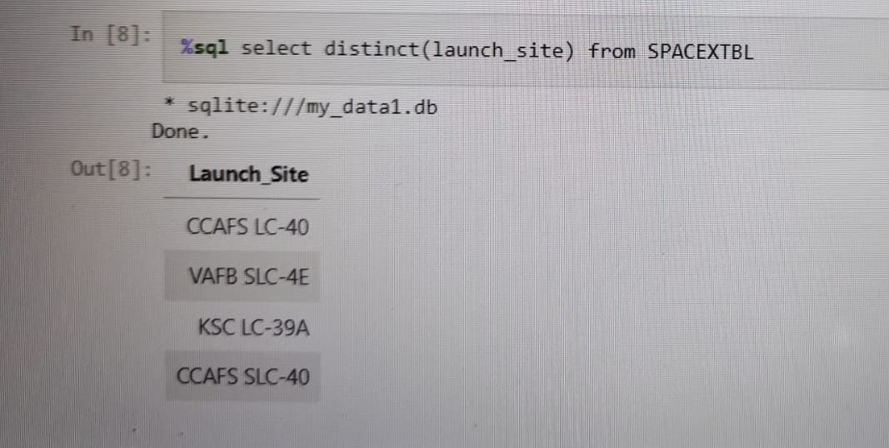
All Launch Site Names
The command distinct was used to show only unique launch sites from the SpaceX data.

Slide 27
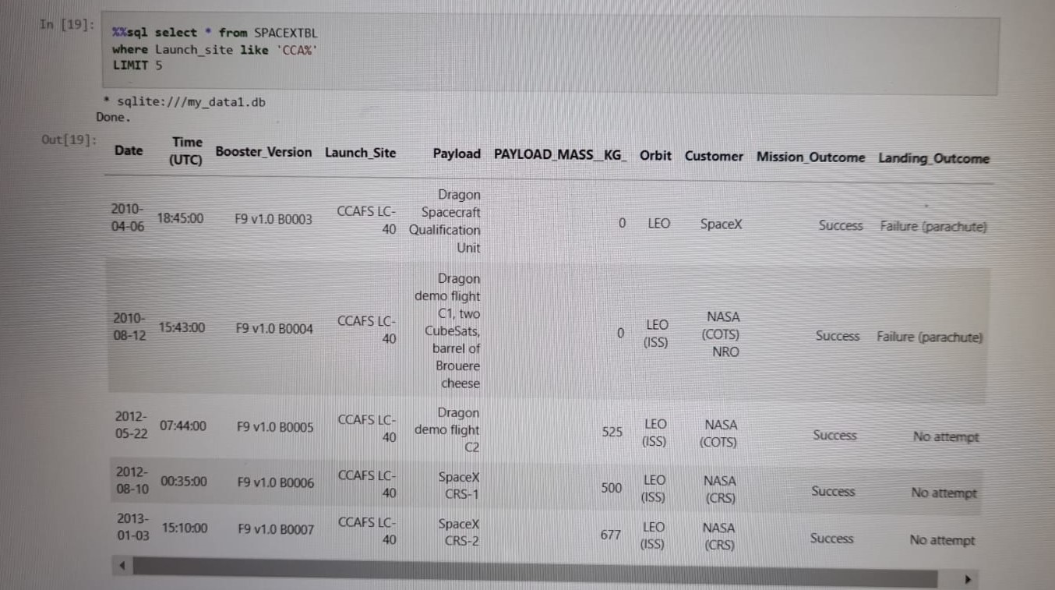
Launch Site Names Begin with 'CCA'
We used the like command to display launch sites that begin with `CCA`. Also, with the command limit we restrict the query to only the first 5 records.

Slide 28
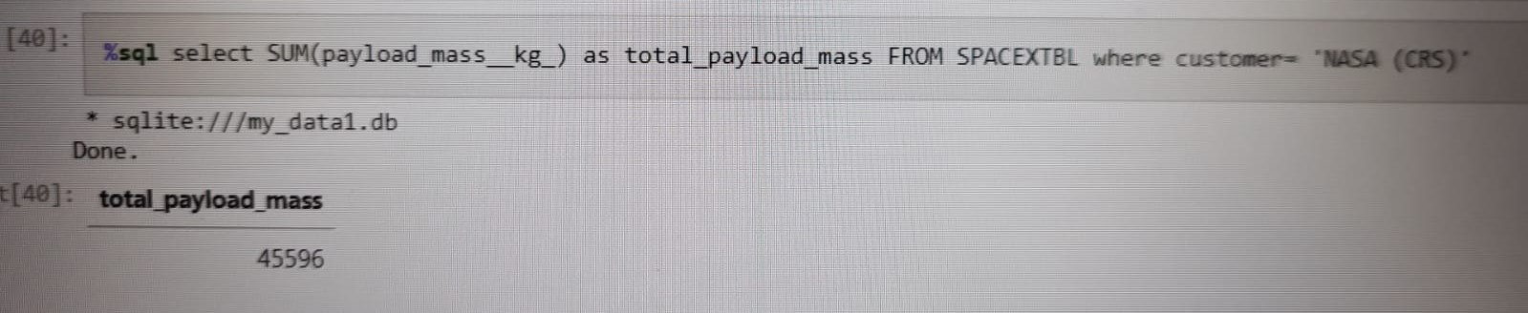
Total Payload Mass
We calculated the total payload mass carried by boosters launched by NASA (CRS) using the where clause. The total payload mass was 45,596

Slide 29
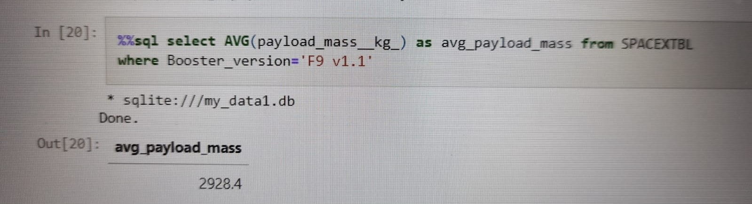
Average Payload Mass by F9 v1.1
We display the average payload mass carried by booster version F9 v1.1 using the where clause. The average payload mass was 2,928.4

Slide 30
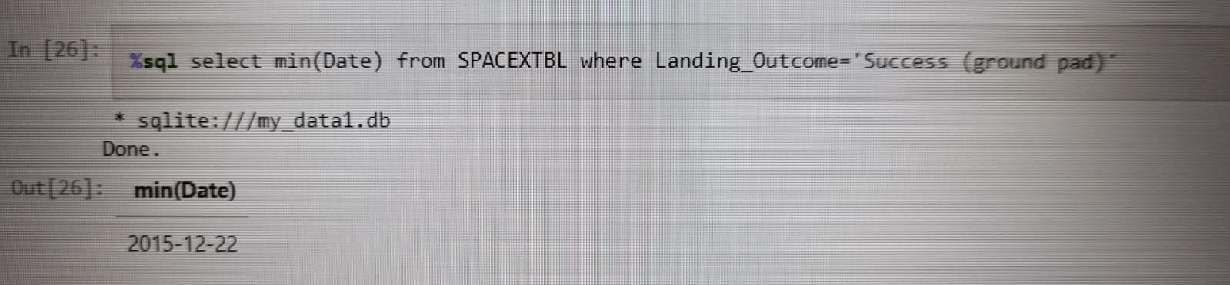
First Successful Ground Landing Date
We see that the first successful landing outcome in ground pad was achieved December 22th of 2015. To display this query we use the min function.

Slide 31
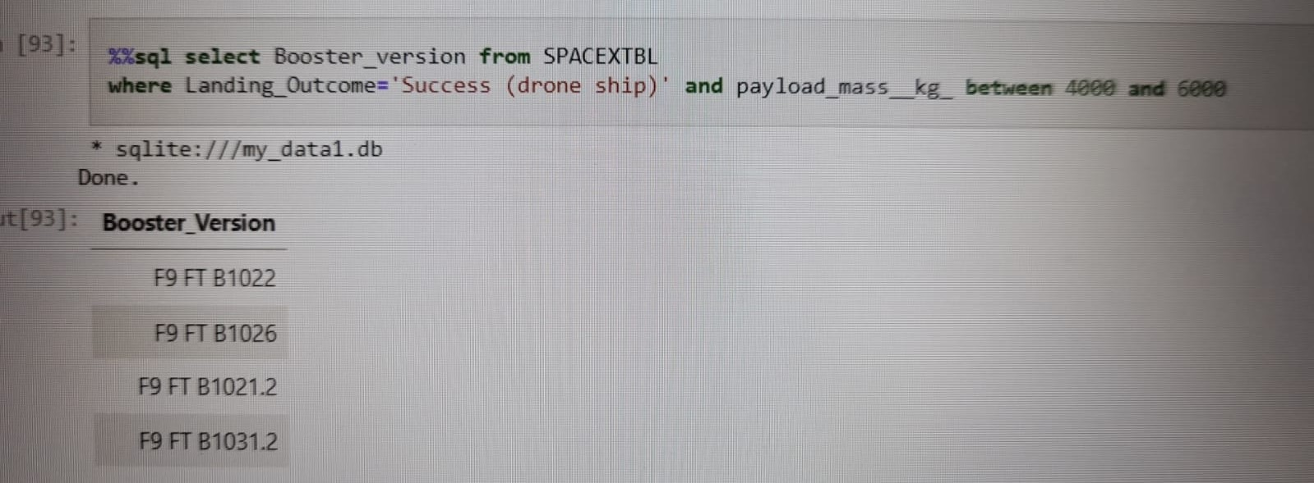
Successful Drone Ship Landing with Payload between 4000 and 6000
We list the names of the boosters which have success in drone ship and have payload mass greater than 4,000 but less than 6,000. For achieving this query we used the where clause to filter for boosters which have successfully landed on drone ship and applied the and/between condition to determine successful landing with payload mass greater than 4000 but less than 6000

Slide 32
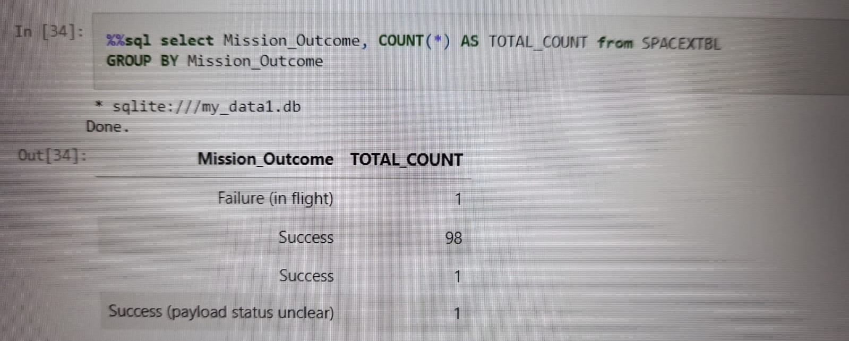
Total Number of Successful and Failure Mission Outcomes
To achieve this query we used the count function and then we apply the group by command for mission outcome.

Slide 33
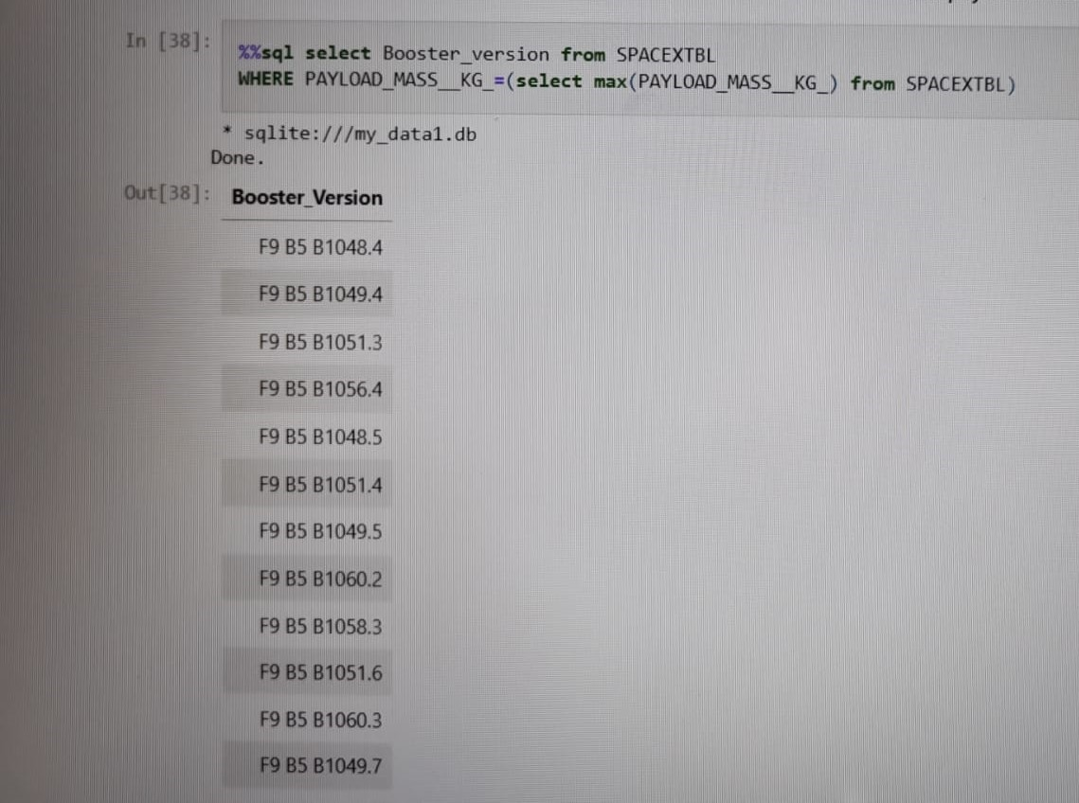
Boosters Carried Maximum Payload
We list the names of the booster version which have carried the maximum payload mass using a subquery, that consist in applying the where clause and the max function.

Slide 34
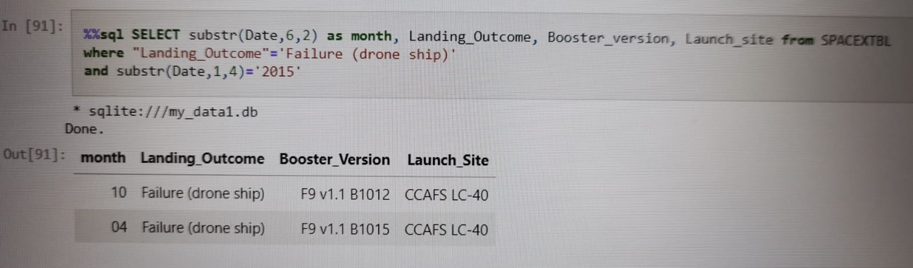
2015 Launch Records
We list the records which display the month names, failure landing outcomes in drone ship, booster versions, launch site for the month in the year 2015. In order to achieve this query we used a combinations of the where clause to filter for failure landing outcomes in drone ship, and the substr function to get the month and year.

Slide 35
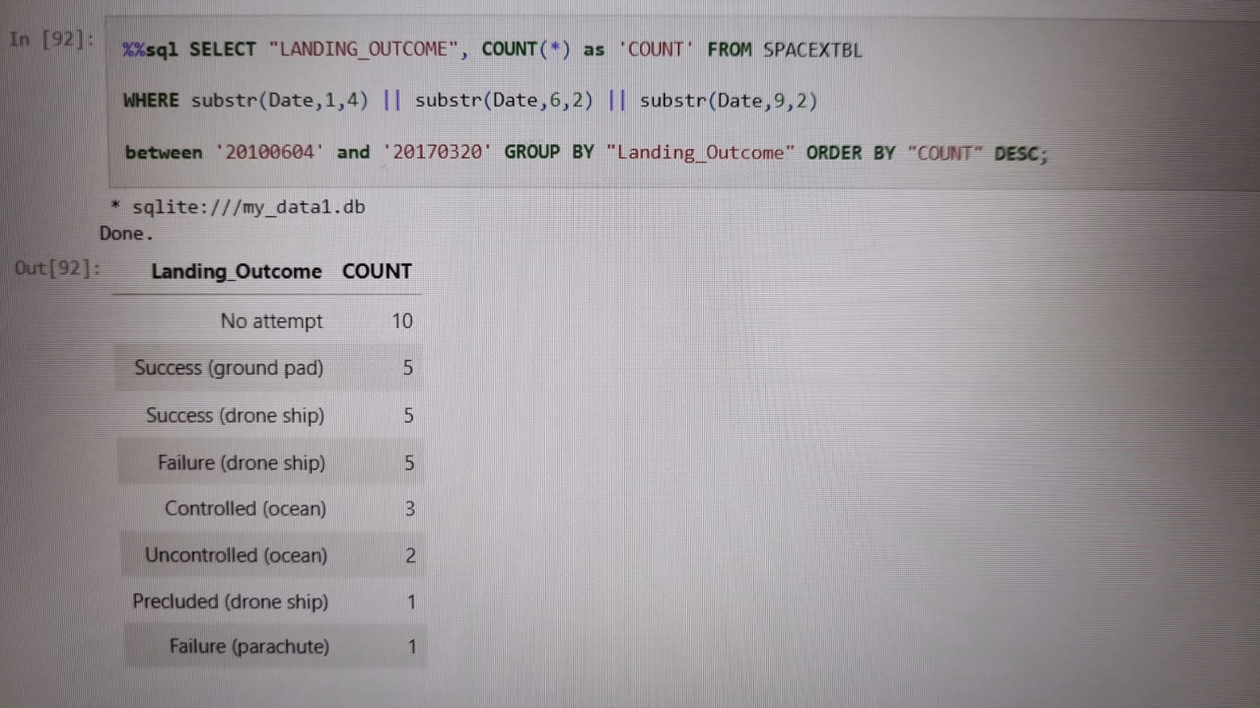
Rank Landing Outcomes Between 2010-06-04 and 2017-03-20
We used count function for landing outcomes and used the where clause to filter for landing outcomes between 2010-06-04 to 2010-03-20.
Lastly we applied the group by clause to group the landing outcomes and the order by clause to order the group landing outcome in descending order taking into account the total count of each landing outcome.

Slide 36

Section 3

Slide 37
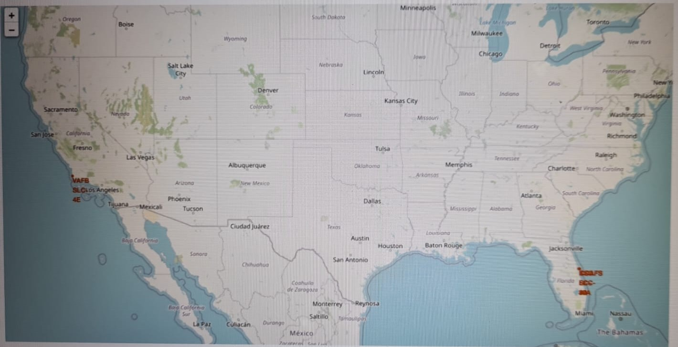
Locations of launch sites
We used the first folium map to see the locations of the launch site. These one are located in the states of Florida and California.

Slide 38
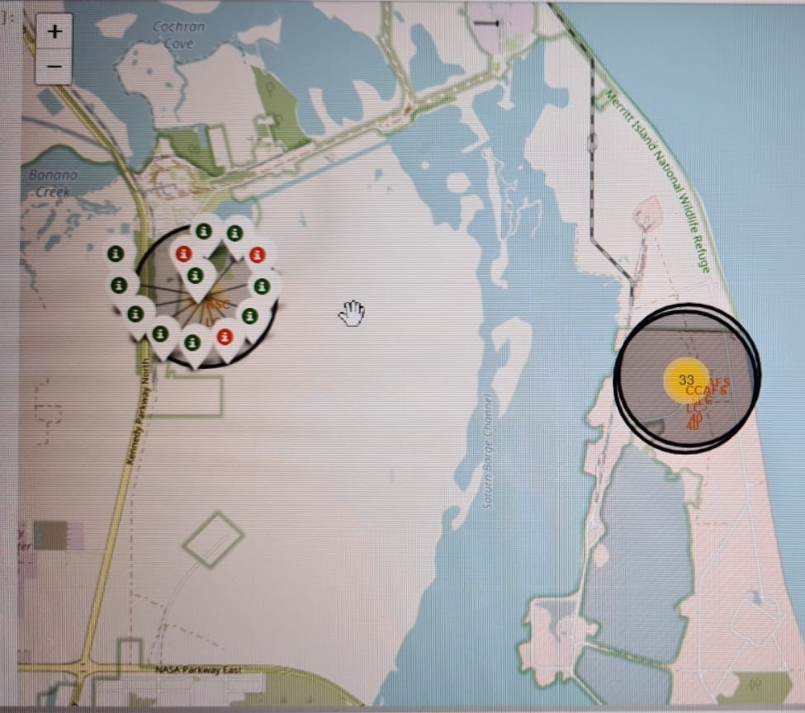
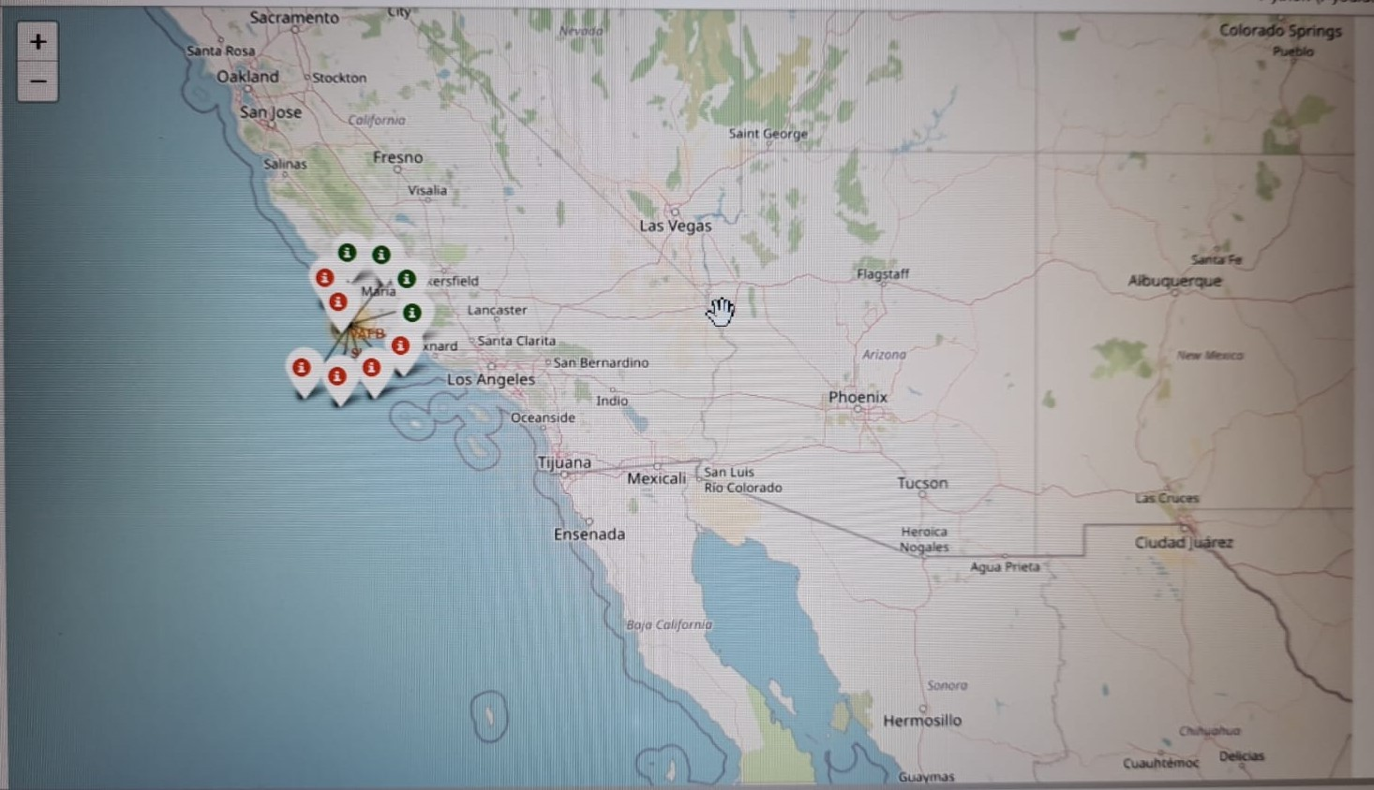
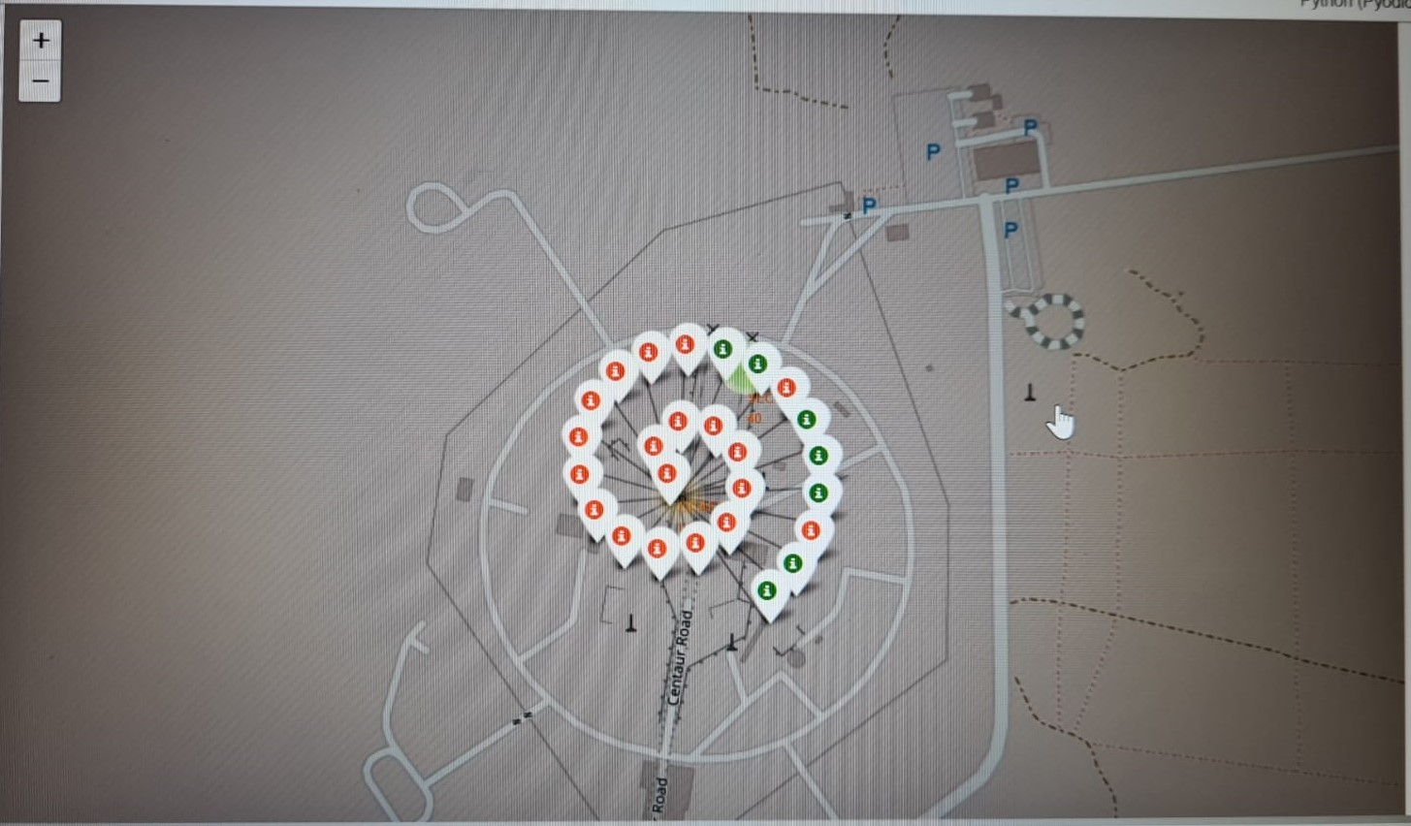
Success and Failure launches in each location
We can see in the pictures below all the rocket launch that take place in Florida Launch sites and in California launch site.
Green marker shows successful launches while red marker shows failures launches.

Slide 39
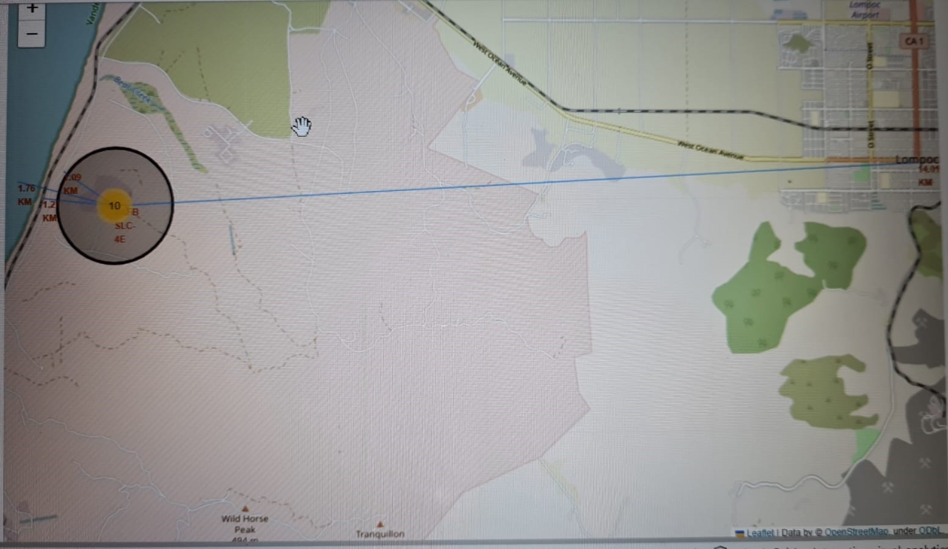
Location distance to proximities
In the picture we can appreciate the California launch site.
This launch site is in close proximity to railway and also to a highway
About the coastline is a bit far from the launch site than railway and highway but we can say that not too far (less than 2 km)
About the near city to the launch site is far away.

Slide 40

Section 4

Slide 41
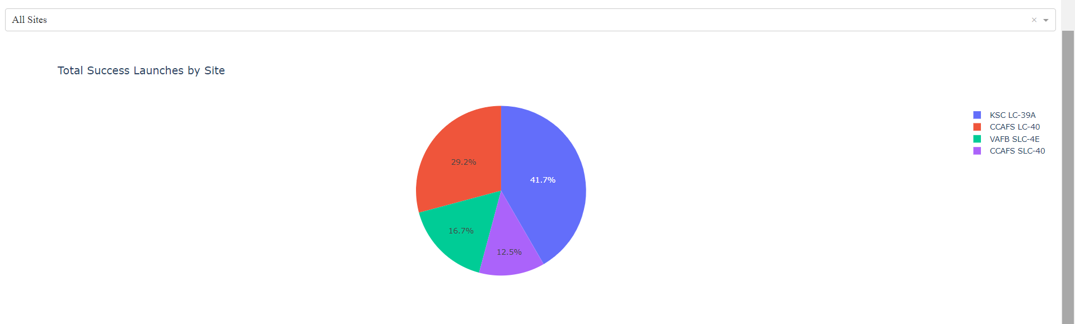
Launch success by site
We can see that the KSC LC-39A launch site has the most successful rate of launches.
Among the four launch sites, the one mention represent the 41.7% of all the success launches that take please.

Slide 42
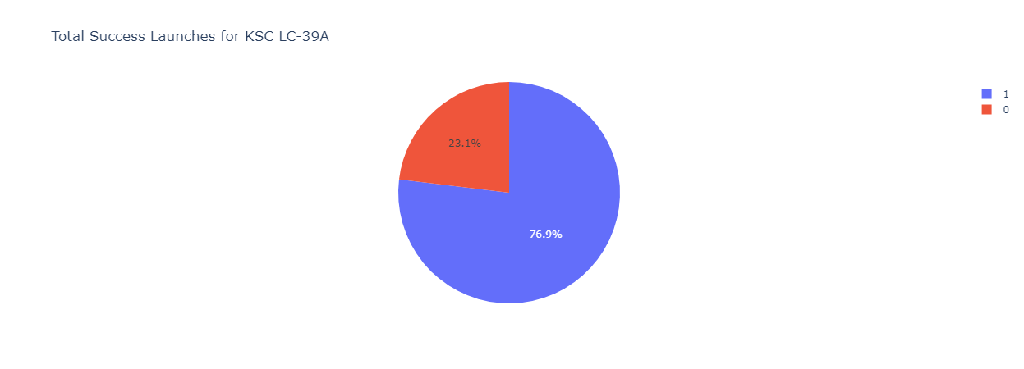
Success and fail of KSC LC-39A launch site
We see in the last slide that KSC LC-39A represent the location with the major percentage of successful launch.
Taking into account only this location we can see in the pie chart below that 76.9% of the total launches that take place in this location where success and only 23.1% fail.

Slide 43
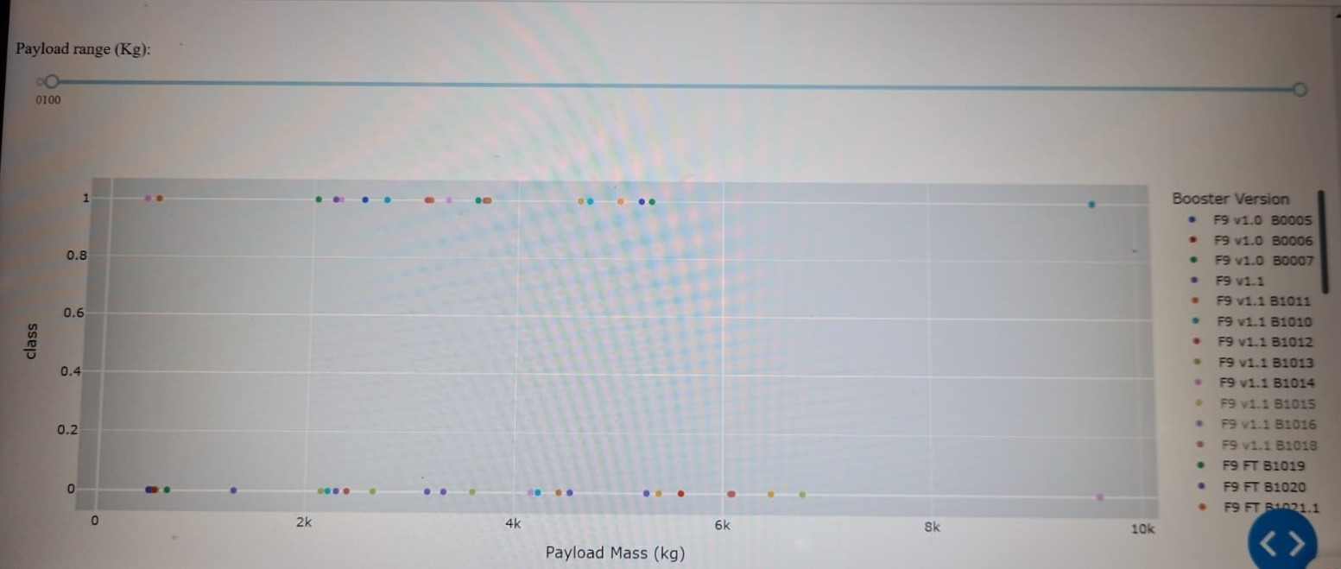
Payload mass vs Launch outcome for all sites
We can see that the success rate for low weight payload is higher than for heavy weight payload.

Slide 44

Section 5

Slide 45
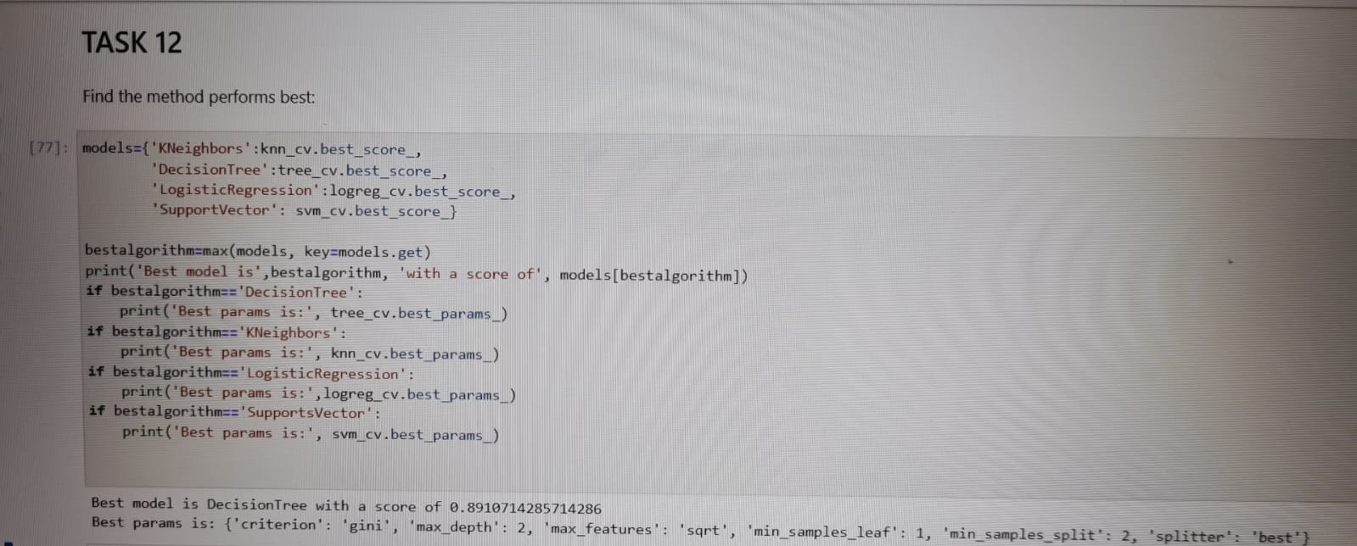
Classification Accuracy
The decision tree classifier is the model with the highest classification accuracy.

Slide 46

Confusion Matrix
The confusion matrix for the decision tree classifier shows that the classifier can distinguish between the different classes.
The major problem is the false positives .i.e., unsuccessful landing marked as successful landing by the classifier.

Slide 47
Conclusions
We can conclude that:
The larger the flight amount at a launch site, the greater the success rate at a launch site.
Launch success rate started to increase in 2013 till 2020.
Orbits ES-L1, GEO, HEO, SSO, VLEO had the most success rate.
KSC LC-39A had the most successful launches of any sites.
The Decision tree classifier is the best machine learning algorithm for this task.

Slide 48


